Slide 1
Monthly Business Review
Telstra
Bangalore
June 2026

Slide 2
The Counter Sales stood at 2.80L with around 6.9K of orders in June’26
The Total Counter Sales stood at INR ~2.80L which is a ~5.64% Equal from INR 2.8L in May’26,
6927 orders were served in June’26 which is ~2% less orders ~7173 orders were served in May’26
The Total Feedback rating received were 166 in which ~95% customers were satisfied with the food and cafeteria services.

Slide 3
Weekday wise Orders
Tuck Shop Outperformed Meal Counter: The Tuck Shop recorded a higher total of ~3707 orders, compared to ~3220 orders from the Meal Counter— ~20% more overall.
Change in Midweek Demand: Tuck Shop saw stable and higher footfall from Tuesday to Thursday, indicating peak midweek engagement. However, the meal counter saw highest demand on Tuesday with steady decline as the week progresses.
Weekend Dip in Orders: Saturday and Sunday recorded the lowest orders for both Meal Counter and Tuck Shop, suggesting reduced footfall or early logoffs.

Slide 4
HSEQ - Site Audit
The Overall Site HSEQ Audit score is 76% in May -2026

Slide 5
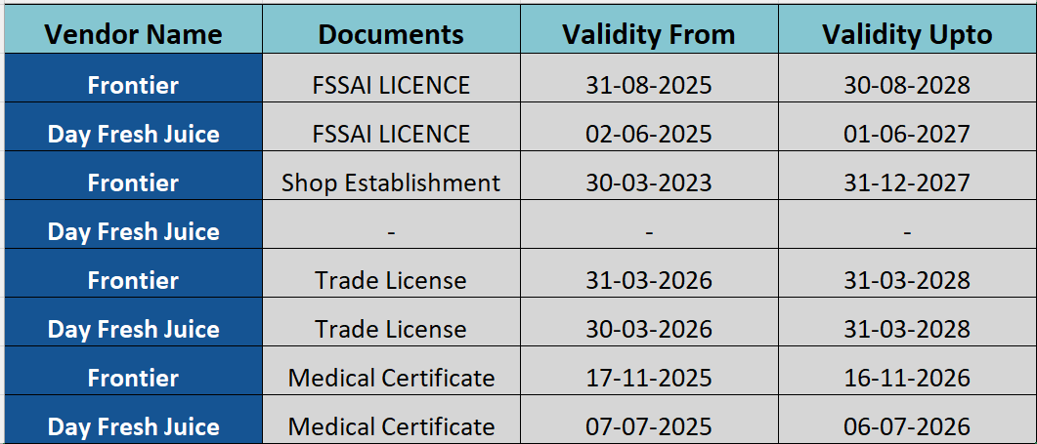
Compliance Tracker Status

Slide 6
Vendor Staff Medical Examination Tracker

Slide 7
Events in June 2026

Slide 8
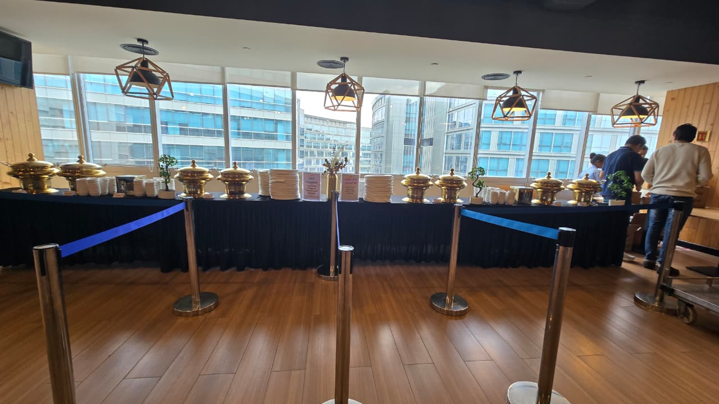
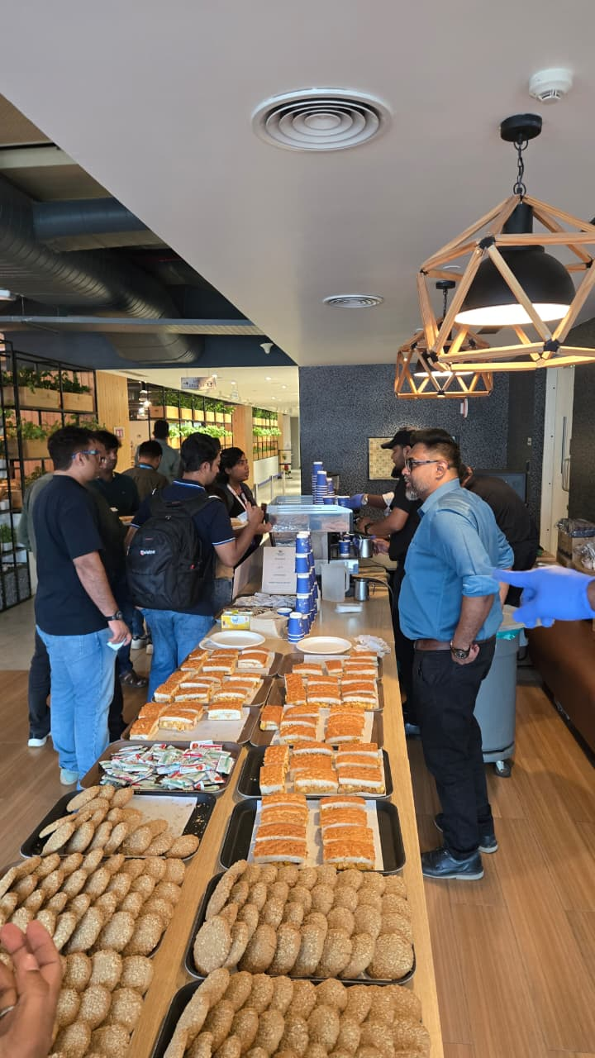
02 JUNE 2026 BLR MITE EVENT :-
Successfully Completed the entire Event.

Slide 9
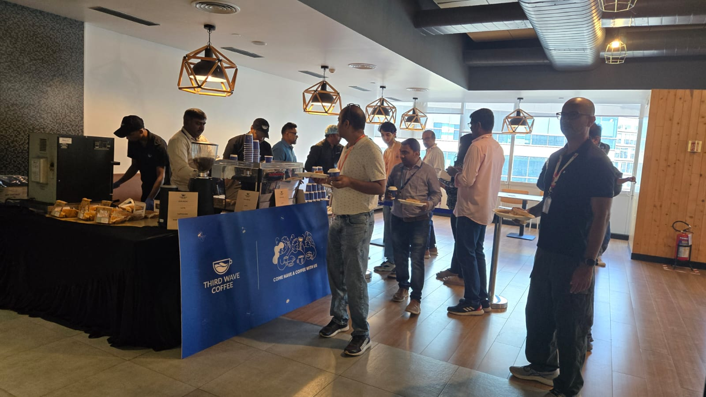
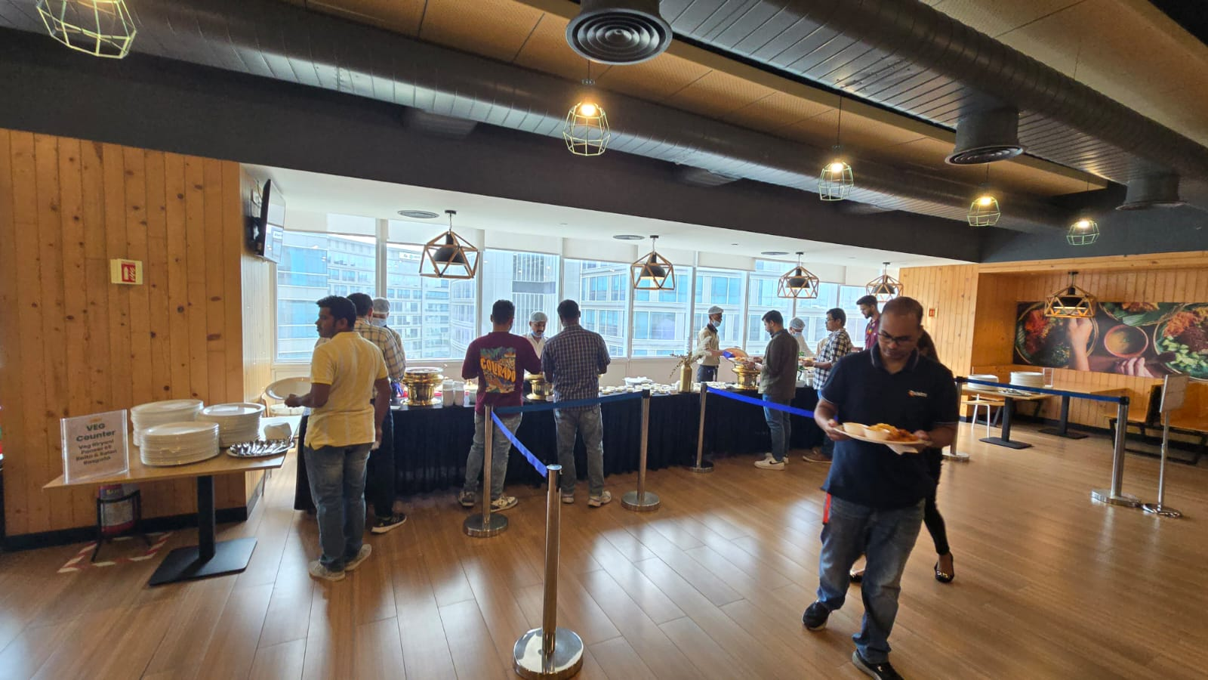
02 JUNE 2026 BLR MITE EVENT :-
Successfully Completed the entire Event.

Slide 10
Training session for the staffs:-

Slide 11
Thank You

